Slide 1

Department of Computer Science & Engineering
Batch Number: 27
Synopsis Presentation on
Project Title: Using facial landmarks to detect drowsiness
NAME USN
Srikar Koushik Satya Viswanadha 19BTRCS103
Vellala Harshith 19BTRCS083
Akash P 17BTRCS114
Kothapalli Bhargava Avinash 19BTRCS087
Guide Name: Dr. Rajesh A
Designation & Dept: CSE
College Name: Jain University

Slide 2
Contents
Abstract
Introduction
Objectives and Scope of the project
Methodology
Hardware & Software Requirements
References/Bibiliography

Slide 3
ABSTRACT
The proposed system aims to detect the real-time drowsiness of a person which can be further used in advancements like driver drowsiness detection system and many more.
Based on computer vision techniques, the person’s face is located from a image captured from camera using OpenCV and various techniques are applied on those captured images to determine whether the person is feeling drowsy.
The proposed approach consists of capturing real-time images from the camera, mapping 68 facial landmarks to the captured frame using dlib module, calculating the EAR(Eye Aspect Ratio) and comparing it to the standard EAR(0.3) to determine the drowsiness of the person.

Slide 4
INTRODUCTION
A person fatigue can happens due to various reasons like tiredness, lack of sleep etc.
This project detects whether a person is feeling drowsy or not based on the EAR. This can lay a further platform to built various systems.
In road transport drowsiness is the main reason to cause accidents. One of the recent study shows that one out of five road accidents are caused by drowsy driving which is roughly around 21% of road accidents, and this percentage is increasing every year as per global status report on road safety 2015, based on the data from 180 different countries.
Apart from transport there are many services that gets effected due to person feeling drowsy.

Slide 5
INTRODUCTION
Real time drowsy driving detection is one of the best possible solution that can be implemented to assist people to make them aware of drowsiness at work.
There are several techniques mentioned in several studies to detect a person drowsiness.
The technique used in the project to detect drowsiness is EAR(Eye Aspect Ratio) technique and if it detects drowsiness it alerts the person using an alarm sound.
As mentioned earlier a mapping is done to the image and ratio calculations are performed to detect drowsiness.

Slide 6
OBJECTIVES
Design a real-time system using image processing to capture person’s eye state.
Develop an algorithm to analyze the interval of eye closure and detect the drowsiness in advance.
Warn the person using sound alerts and increase the intensity as time passes.
Design the system in a non-intrusive way so that the person doesn’t feel uncomfortable.
To increase the accuracy of the model to develop it further so that it can be used in real-time scenarios.

Slide 7
SCOPE OF THE PROJECT
Fatigue is a safety problem that has not yet been deeply tackled by many countries in the world mainly because of its nature. And due this the percentage of road accidents ,decrease in work efficiency and mental health problems arises.
The future scope of the project is to implement it in useful cases such as to detect driver drowsiness in automobile sector, to make securities to alert them in their work and many more.
Further scope of the project is to develop it into more accurate model and make more advancements.

Slide 8
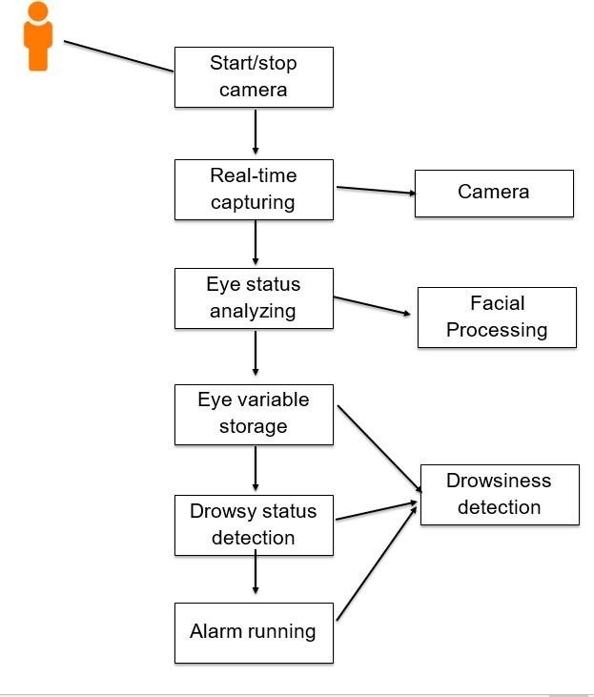
METHODOLOGY

Slide 9
METHODOLOGY
The proposed system comprises of three phases.
Face Detection:
The proposed system will start by capturing the video frames one by one. The system will detect the face in the frame using dlib library. Then the system maps the 68 standard facial landmarks from the shape predicator of dlib module.
EAR Detection:
In this stage, the landmarks of the right eye and left eye are extracted.
Each eye has 6 landmarks 2 bottom and top and also one left and right. These landmarks has particular number from the standard 68 landmarks.
Left eye in the range of 36 to 41 and right eye ranging from 42 to 47 which returns an x,y co-ordinates that will be used to calculate Eye aspect Ratio.

Slide 10
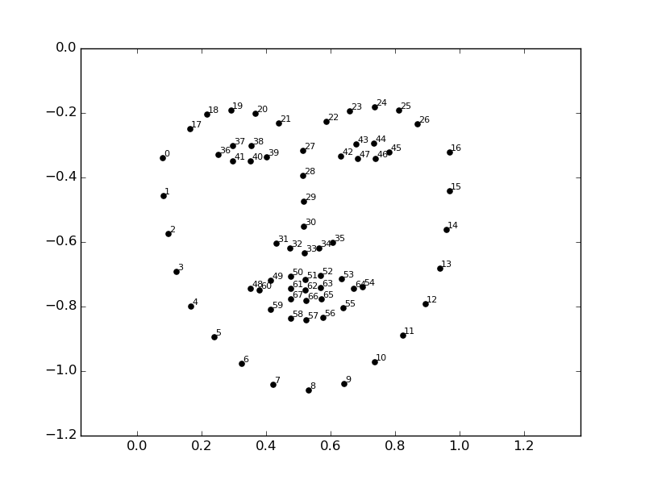
METHODOLGY

Slide 11
METHODOLOGY
Drowsiness Detection and Alerting:
The aspect ratio has a ranges after which the person considered to be closing eyes. If the ratio passes the maximum threshold (Standard aspect ratio is 3) the person is considered drowsy if the aspect ratio passes the maximum.
The score is maintained based on the persons state which will be later used to determine whether person is feeling drowsy or not.
If the score passes a value which is to be considered drowsy then an alert is sent to the user to make the person aware of the drowsy feeling.

Slide 12
HARDWARE & SOFTWARE REQUIREMENTS
System requirements:
8 GB RAM
Camera (which can process 30fps).
256 GB basic storage.
Intel i5 8th gen processor.
Software requirements:
Python
OpenCV
dlib
PyGame

Slide 13
REFERENCES
Bradski, G. (2000). The OpenCV Library. Dr. Dobb&#x27;s Journal of Software Tools.
Anil Kumar Biswal, Debabrata Singh, Binod Kumar Pattanayak, Debabrata Samanta, Ming-Hour Yang, "IoT-Based Smart Alert System for Drowsy Driver Detection", Wireless Communications and Mobile Computing, vol. 2021, Article ID 6627217, 13 pages, 2021.
Davis E. King. Dlib-ml: A Machine Learning Toolkit. Journal of Machine Learning Research 10, pp. 1755-1758, 2009
PyGame Documentation | Documentation from PyGame Developer Community | https://www.pygame.org/docs

